Slide 1
Understanding Git and Best Practices

Slide 2


Hello!
I AM HOWIE REITH
Software Developer
Howard.Reith@gmail.com

Slide 3
Contents
We will discuss:
Why Git?
Useful Git Commands
Merging vs. Rebasing
Git Flows
Final Thoughts

Slide 4
Why Git?
1

Slide 5
Why Git?
Why would we want to use Git?
Keep track of changes and who made them.
Remote storage to back up our work.
Option to revert back to previous versions.
Collaborate across distant geographic locations.
Github/Gitlab offers additional features like a project wiki, issue tracking, etc.

Slide 6
Why Git?
What are the liabilities to using Git?
Its complexity can slow down continuous integration for individuals or very small teams.
The CLI is arcane.
When poorly used, the benefits of the system will not be enjoyed, and the resulting merge conflicts and lost code will consume more resources than a simpler solution would have.

Slide 7
Useful Git Commands
2

Slide 8
Useful Git Commands
git add --all -p
git add --all will add all changes in your local repository to be staged for commit. The -p tag allows us to evaluate those changes in chunks. It’ll help keep you from checking in commented-out code, prints to the console, imports that you brought in but removed, and mistakes.

Slide 9
Useful Git Commands
git commit --amend --no-edit
Ever been working on code, think you’re done, commit, and then discover another change you need to make? Now you have to do a whole new commit just for this small tweak. Not any more. This’ll let you add your changes to your previous commit without modifying anything else about it.

Slide 10
Useful Git Commands
git checkout -b [branch name]
Create a branch and checkout to it at the same time.

Slide 11
Useful Git Commands
git merge --squash [branch name]
Merge the [branch name] into your current branch, but instead of doing it through git’s default process, it will bring all the changes into your current branch and stage them as if you’d made all those changes in this branch and done a git add --all. This will keep your git history a bit cleaner by making all these changes a single commit while also giving you the power to give this merge whatever name you prefer.

Slide 12
Useful Git Commands
git pull -r --autostash
You’ve started working on your feature when you realize you forgot to pull in your team’s changes from yesterday. This command will stash all your local changes, pull down changes from the remote, and then immediately pop your local changes back, all in one command.

Slide 13
Useful Git Commands
git reset --soft HEAD~1
You just did a commit and realized you have more work to do, so you need to remove that commit. Voila. This command will revert your last commit and leave all your changes staged, but uncommitted.

Slide 14
Useful Git Commands
git reset --hard
This command will reset all your files and your current git status to the state of your last commit. If you specify a commit number as a parameter, e.g. git reset --hard 8b04fd5, this will set all your files to the state of that commit. If you pass in something like “origin/master,” it will set everything to the state in your current remote master. It’s a useful “get out of jail free” card as well as a way to experiment with different states in your project’s history.

Slide 15
Useful Git Commands
git grep [phrase]
Searches your entire codebase for a given phrase and tells you the file(s) in which it appears. Probably something you ought to use your IDE for, but it can be useful.

Slide 16
Useful Git Commands
git bisect
This is a command that deserves a whole tutorial on its own and is beyond the scope of this presentation, but I’m mentioning it because it’s powerful. Imagine you have a bug that’s been introduced into your code that’s been discovered in production, but you’re not sure when or where the bug was introduced. This command allows you to go through your commits and identify that bug. It has other applications, but this is the amazing one.

Slide 17
Merge vs. Rebase?
3

Slide 18
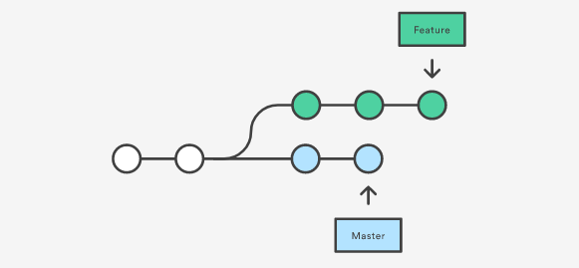
Merge vs. Rebase?
Both git merge and git rebase are commands designed to integrate one branch into another. Which is better depends on context.
Imagine you’re working on a branch forked off of master. Another teammate continues work in master and pushes it. You now have a forked history.

Slide 19
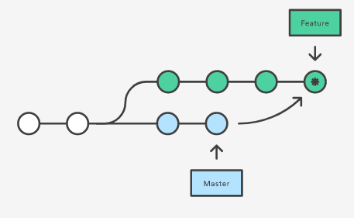
Merge vs. Rebase?
Let’s say you want to merge master into your feature branch, so you run “git checkout feature” and then “git merge master”
This creates a “merge commit” in your feature branch that brings changes in the master branch into your branch.

Slide 20
Merge vs. Rebase?
This process preserves the integrity of all existing branches. The main downside (for our current goal) is that it will have an extraneous merge commit, and each time you bring in master, you’ll have yet another such commit. This can be confusing for someone looking at the git history trying to evaluate what changes happened when and how.
Additionally, if there have been multiple commits in master, these will all be brought in at the same time with this merge. This can be confusing to work through if those commits modify the same files.

Slide 21
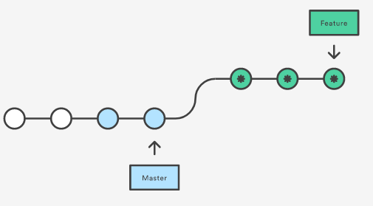
Merge vs. Rebase?
The alternative to merge is rebase. Let’s imagine we’re solving the exact same problem except, this time, we use “git rebase master” instead of merge.
Instead of creating a merge commit, git rebase rewrites the project’s history so it looks like all of the pulled-in branch’s changes occurred in this branch.

Slide 22
Merge vs. Rebase?
The benefit of this approach is it provides a clearer history of the project. It eliminates the merge commits and provides a perfectly linear project history. Perhaps most importantly, it allows you to bring in changes one commit at a time through interactive rebasing (git rebase -i). This can significantly simplify the difficulty of working through merge conflicts and will prevent the loss, or incorrect implementation, of merged code.

Slide 23
Demonstration
Visualizing Git Tool

Slide 24
Merge or Rebase?
Merge Advantages:
Preserves history.
Consolidates commits into one merge commit.
Rebase Advantages:
Rewrites history into a linear path.
Deal with conflicts one at a time.

Slide 25
Merge or Rebase?
Recommendation:
Merge into Develop/Master. Rebase into branches.
The “golden rule of rebasing” is to never do it into a public branch. In our master and integration branch(es), we care about preserving history, since we may need to navigate through that history to identify problematic commits in the future. However, in our feature branches, we don’t necessarily care about history, but we do care a great deal about bringing our colleagues’ changes in correctly. There’s thus a lot of benefit to interactive rebasing in a feature branch and a lot of benefit to merging in a public branch.

Slide 26
Git Flows
4
Best practices for managing team commits

Slide 27
Git Flows
When evaluating a workflow, you want to use the simplest solution that meets your team’s needs. Consider:
Will the team grow? Will the workflow scale?
Can we easily revert mistakes?
Does this workflow impose unnecessary overhead?

Slide 28
Centralized Workflow
4.1

Slide 29
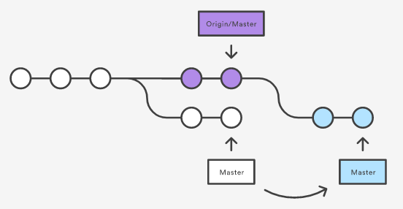
Git Flows – Centralized Workflow
A centralized workflow is one in which all team members contribute to the same branch and same repository. No one diverges from the Master branch and all commits are linear.

Slide 30
Git Flows – Centralized Workflow
Advantages:
Easily enables a linear history which is simple to understand.
Systematically encourages smaller commits, which are less risky.
Requires little understanding of Git.
Lower risk of someone making a Git error that costs hours to resolve later on.

Slide 31
Git Flows – Centralized Workflow
Disadvantages:
Nearly impossible to implement when multiple remote engineers are working on the same task.
Progress can only be “saved” locally.
No distinction between recently-pushed code and production code.
More difficult to keep work independent of others’.
“Work-in-progress” commits can clutter the history.

Slide 32
Git Flows – Centralized Workflow
Opinion:
The centralized workflow is most appropriate for a single or very small number of developers working locally on a project. Even in such a circumstance, losing the distinction between production and development code is extremely reckless. At a minimum, I would recommend taking a page from the Gitflow workflow we’ll discuss shortly and employ a distinct Development branch that you merge into Master when you wish to release. This will differentiate between production and development code and make any production issue debugging a lot easier.

Slide 33
Feature Branch Workflow
4.2

Slide 34

Git Flows – Feature Branch Workflow
A feature branch workflow is one in which all feature development is done in distinct feature branches instead of in the master branch. Branches are only merged into master when completed and working. Branches can and should be pushed to the remote repository allowing geographically distant developers to review and contribute to them.

Slide 35
Git Flows – Feature Branch Workflow
Advantages:
Easily enables remote cooperation on tasks.
Provides confidence that only working code is added to the master branch and production.
Easier to associate a given line of work with a specific feature.
Allows for progress on a feature without interfering with other contributors.

Slide 36
Git Flows – Feature Branch Workflow
Disadvantages:
Heavier load at the end of the feature when the branch is merged back into master.
People can get too comfortable on branches and neglect syncing-up with master.
Git history can be a bit confusing without deliberate effort to make it appear linear.
Branch list can get cumbersome.

Slide 37
Git Flows – Feature Branch Workflow
Opinion:
Any team larger than a few people ought to use branches if for no reason except to provide the option to perform “work-in-progress” commits without polluting the master branch. This gives the team confidence that the production branch only has completed, working code while allowing engineers to “save” their progress in case anything goes wrong. Since the greatest liability of this approach is the complex merges back into master at the end of the feature, it’s wise to periodically rebase the latest master into the feature branch so as to make the final merge that much less troublesome.

Slide 38
Gitflow Workflow
4.3

Slide 39
Git Flows – Gitflow Workflow
On January 5, 2010, Vincent Driessen posted an article on nvie.com titled “A successful Git branching model.” It emphasizes utilizing Git branches not only to document individual feature merges but as a means of keeping track of versioned releases. The Gitflow workflow has been formalized and simplified in the Gitflow library and is among the most popular models used in industry today.

Slide 40
Git Flows – Gitflow Workflow
Instead of a single master branch, Gitflow has two branches that record the history of the project – Master and Develop. The Develop branch serves as an integration branch for all features. Master stays in sync with production.
Each new feature should have its own branch which should be pushed to the central repository for collaboration and review. When a feature is complete, it’s merged into the develop branch. Feature branches never interact with the Master branch.
Once Develop has accumulated enough features for a release, a release branch is forked from the develop branch and tagged with a version number. The release branch is modified as needed and then merged into Master and back into the Develop branch.

Slide 41
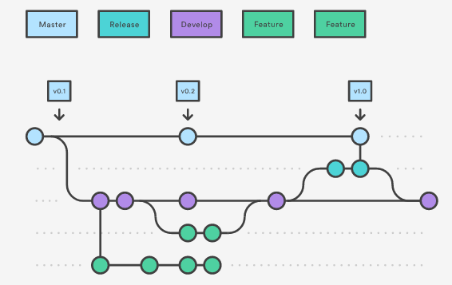
Git Flows – Gitflow Workflow

Slide 42
Git Flows – Gitflow Workflow
Gitflow also allows for “hotfix” branches. In the event a fix needs to be added directly to master without going through the standard release process, a “hotfix” branch can be forked off of Master, the remedying code implemented, and then merged back into Master and Develop. This keeps the code consistent and the release process unviolated while providing a shortcut in the event of emergencies.

Slide 43
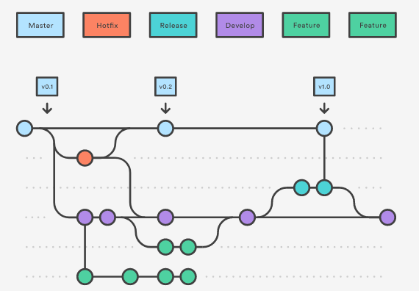
Git Flows – Gitflow Workflow

Slide 44
Git Flows – Gitflow Workflow
Advantages:
Enforces discipline with multiple layers of code integrity before reaching production.
Unparalleled release and commit documentation.
Accommodates remote work with near infinite scalability.
10+ years of industry standard, community, and documentation.

Slide 45
Git Flows – Gitflow Workflow
Disadvantages:
The release process takes more time and care to perform.
Merges are as troublesome as they are for any other workflow involving branches.
Must be careful the team not get reckless with “hotfixes” lest the process become even less disciplined than a centralized workflow.

Slide 46
Git Flows – Gitflow Workflow
Opinion:
It is obvious to me why this has become the industry standard for best Git practices. It achieves a tremendous amount of implicit discipline and documentation for a relatively small price, most especially via the distinction between Master, Develop, Release, and Feature branches. Obviously all flows should be tweaked and altered depending on your team’s unique use case, but generally speaking, for all projects that are not either very small or very large, this is an excellent model from which to start.

Slide 47
Forking Workflow
4.4

Slide 48
Git Flows – Forking Workflow
The forking workflow is a fundamental departure from the workflows we’ve discussed so far. Instead of having a single repository on which all contributors work, every contributor forks their own repository into which they push their commits. Changes are merged via pull requests into the official repository. Only the project maintainers can push to the official repository or approve pull requests. This process allows very large groups, even including untrusted third parties, to collaborate organically on a single project without introducing harmful code to production. It is the standard model for open-source collaboration.

Slide 49
Git Flows – Forking Workflow
Advantages:
Infinite scalability.
Easy to prevent poor quality code from entering production.
Easy for contributors to experiment as they please, since their forked repository is “theirs.”

Slide 50
Git Flows – Forking Workflow
Disadvantages:
Necessitates regular review and maintenance by maintainers of the primary repository.
Extremely non-linear contribution history can be difficult to follow.

Slide 51
Git Flows – Forking Workflow
Opinion:
Being simultaneously the most restrictive at the main repository level and most permissive at the fork level, it’s understandable why this is the standard approach for open source development. It nevertheless involves a great deal of overhead. Maintainers need to review every pull request and contributors need to keep their forks up-to-date. It’s a model that makes perfect sense for a massive project involving hundreds or thousands of engineers, but it’s probably too heavy-handed for a small team.

Slide 52
Final Thoughts
5

Slide 53
Final Thoughts
The complexity of your Git process should be proportional to the complexity of your project’s needs. If your project is small, you don’t need the overhead of branches and pull requests. If your project is large, circumventing these features would be reckless and lead to a lot of errors being introduced into production. Your job as an engineer is to determine your needs for your use case.

Slide 54
Final Thoughts
Suggestions:
No matter the size of your project, set up Master and Develop branches to differentiate integration and production code.
If you’re working alone, a centralized workflow is probably fine.
If few but multiple engineers are collaborating, especially remotely, start with a feature branch workflow.
If you’re doing an open-source project or have hundreds of engineers on one project, consider a forking workflow.
For all other mid- to large-sized projects, you should probably start at Gitflow workflow and modify as needed.

Slide 55
Final Thoughts
Suggestions:
Always pull the latest Develop when starting a new branch.
If you’re checked out to a branch for multiple days, consider rebasing with Develop to avoid a nightmare merge in the end.
Identify “milestones” in feature development and commit at each one. Small commits are easier to merge.
Never push directly to master. Only merge into it.
Keep the histories of your public branches elegant and linear. Use merge with --squash.

Slide 56
Bibliography
Git-scm Documentation
Visualizing Git Tool
“A Successful Git Branching Model”
Seth Robertson Best Practices
Git Tower best practices
OhSh*tGit.com
Don’t Mess With Master
Rebase vs. Merge

Slide 57
Thanks for watching!
ANY QUESTIONS?
You can contact me at
Howard.Reith@gmail.com

